Slide 1


EAAI Team Summary
<Xiugou King>
23 – March 2022

Slide 2
Executive Summary
Problems: We found that banking industries often have to process a huge amount of information or data statistics. In recent years, most enterprise systems do not have the function of intelligent batch processing, and it often takes a lot of manpower and time to extract the target information in the file. These are very tedious and boring repetitive tasks.
Solutions: Therefore, we thought of using RPA+chatbot technology to develop an intelligent document processing and intelligent data analysis results. Use this technology to recognize complex textual information and customer needs.
The value we create: For enterprises, reduce labor and time costs and improve work efficiency; for customers, increase customer satisfaction during the use of the system.

Slide 3
Table of Contents
Executive Summary Page 2
Team members Page 4
Problem statement Page 5
Solution goal Page 6
Customer segment and persona Page 7-9
Main personnel constitutes structure Page 10
Stakeholders map Page 11-13
List of candidates for Customer testing Page 16-17
Interviews with relevant experts Page 18-24
Storyboard Page 25-27
Prototype Page 28-32
Slide Deck Page 33-36
Summary of learnings Page 37-42
Customer journal Page 45-47
Lightning Demos Page 48-50
Expert interviews Page 51-54
Customer Interviews Page 55-61

Slide 4
Team Name & Members
Our Team Number is: 28
Our Team Name is: Xiugou King
Our Team members are:
Tianhao Xu 2740825
Zeyang Zhang 2726114
Ruijia Lei 2733510
Han Lin 2724786
Yunan Lyu 2701217
Yiyang Qi 2721018

Slide 5
Problem statement
The working process in the bank requires lots of human resources and paperwork. However, working hard has no longer been the most dominant part of business success. Instead, people need to work smart. Redundant and formative works were squeezing dry the creativity of work and were a waste of human resources. People sit and type, fill and shred forms, come and go like walking dead. What spurred the business towards success was never the unreasonable resource management that transformed humans into machines. The tedious hard work should require only hard-working machines, not humans anymore.
To conclude, the main challenges are to improve the efficiency of the working process and to spare the limited human resource from redundant work.
Our team aims to improve the working process in the banks like opening and closing the account, whilst cutting waste of human resources and removing redundant workload.

Slide 6
Solution goal
The long term goal offers digital and intelligent transformation for our enterprise business customers like banks and financial institutions, by solving the applied combination of RPA and AI technology to form a wider range of services such as our main project the interactive intelligent customer service system about financial consulting and banking, it can handle simple and repetitive tasks for assisting stuff like core intent selection, splicing intelligent query from a self-developed knowledge base and automated process handling, whilst maximize the efficiency, increase employee engagement and productivity meanwhile improve customer satisfaction.

Slide 7

Quick persona
Background:
Challenges:
Bank counter, 3 years ago
lobby manager at Finance Enterprise, 1 year ago
Communicate with customers
Handle complex business relationships
Demographics:
Common Objections:
Lily Matthews
Female
Age 28
Annual Income $ 200000
Stressful office environment.
Hobbies & Interests:
Reading
Dancing
Participate in team projects
Goals:
Biggest Fears:
Have more vacation
Promotion to higher paying positions
Company layoffs
Inability to build good relationships with colleagues

Slide 8

Quick persona
Background:
Challenges:
Web front-end development programmer, 5 years ago
Project managers at Internet-based companies.2 years ago
Coordinate between different teams
Develop and maintain the company's online systems
Demographics:
Common Objections:
Dylan Liu
Male
Age 29
Annual Income $ 50000
The company’s overtime system
Low-quality code for employees
Hobbies & Interests:
Karaoke
Watching movies
Rock climbing
Goals:
Biggest Fears:
Lead a larger team
Have a Retirement Plan
Add Text Here
Endless overtime due to company needs
Lack of room for advancement

Slide 9

Quick persona
Background:
Challenges:
Working in marketing more than 10 years
Attract more customers with reputation
Learn digital knowledge for business transformation
Demographics:
Common Objections:
Jack Pearson
Male
Age 48
Annual Income $ 100000
Employees are not united
Hobbies & Interests:
Playing Golf
Playing soccer
Photography
Self-driving tour
Goals:
Biggest Fears:
Have fewer working time per week
Have a Retirement Plan
Business losses after retirement
Difficult to keep up with the digital transformation of enterprises

Slide 10
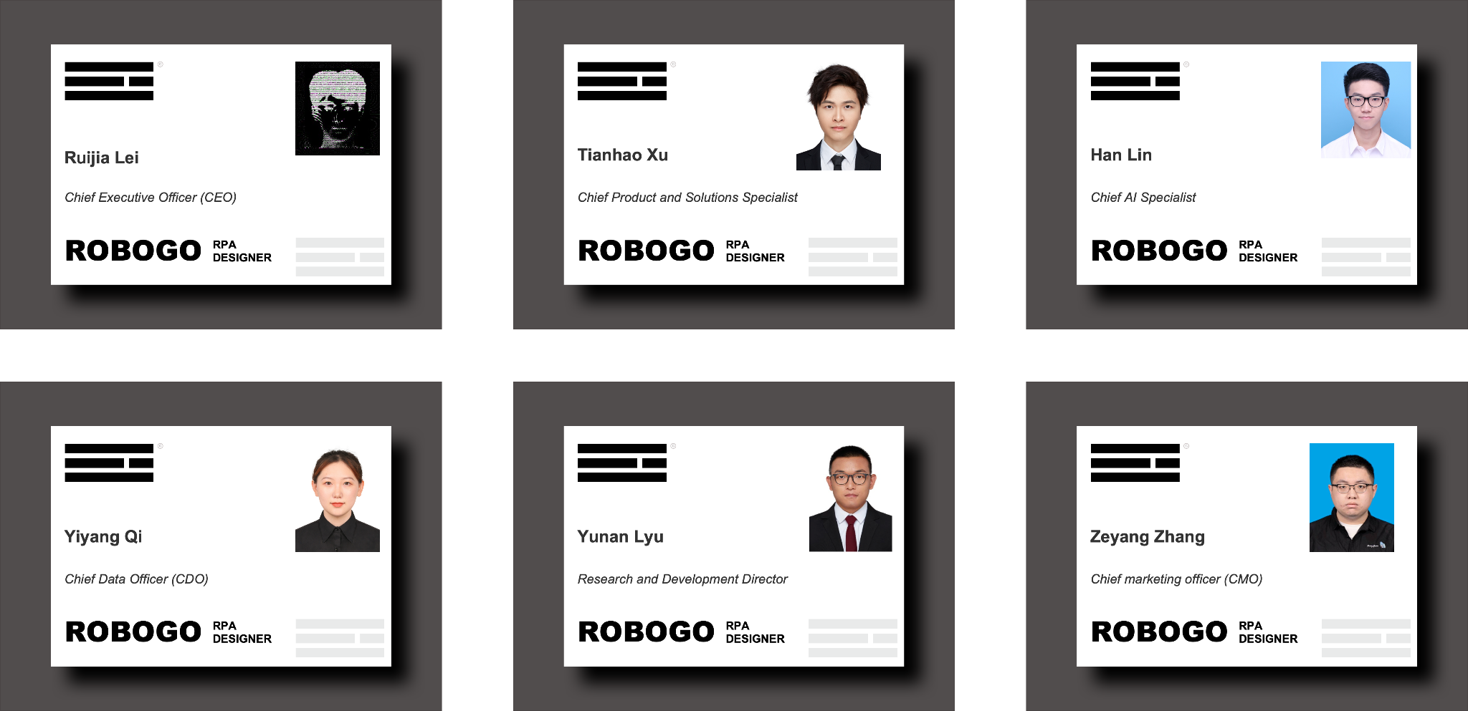
Main personnel constitutes structure

Slide 11
Stakeholder Matrix - Please duplicate the slide, if you have multiple matrices
Stakeholder | Role / Position | Role in the project | Aware? | Interested? | Power
Tianhao Xu | Chief Product and Solutions Specialist | Product landing |  |  | High
Yunan Lyu | R&D Director | Research and Development |  | Somehow | Medium
Zeyang Zhang | CMO | Market Manager | Somehow | Somehow | Medium
Han Lin | Chief AI Specialist | Provide AI Technical Support |  |  | Medium
Ruijia Lei | CEO | Business Decision Maker |  |  | High
Yiyang Qi | CDO | Management of information and data |  |  | Medium

Slide 12
Stakeholder Matrix - Please duplicate the slide, if you have multiple matrices
Stakeholder | Role / Position | Role in the project | Aware? | Interested? | Power
Robert Swaak | CEO of ABN | Project Sponsor |  | somehow | High
Linda Mayer | Leader of HR department | Customer |  |  | Medium
Sigrid Kaag | Minister of Finance | Government | Somehow | Somehow | Low
Daniel He | Employee | Product Developer |  |  | Medium

Slide 13
Stakeholder Action Plan for top 6 stakeholders
Stakeholder | Role / Position | Role in the project | Power | How to involve? | Actions
Tianhao Xu | Chief Product and Solutions Specialist | Product landing | High | Responsible for the product lifecycle | Make the product solutions
Robert Swaak | CEO of bank | Project Sponsor | High | Debit | Receive principal and interest
Ruijia Lei | CEO | Business Decision Maker | High | Management of the innovation process | Capital input
Zeyang Zhang | CMO | Market Manager | Medium | Explore the Market | Pricing and market search
Han Lin | Chief AI Specialist | Provide AI Technical Support | Medium | Participate in product research | Decide short-term and long-term technology direction
Linda Mayer | Header of HR department | Customer | Medium | Participate in product testing | Participate directly in the implementation process and continuously provide comments and suggestions.

Slide 14
Relevant experts
Expert | Role / Position | Attitude ☹ 🡨🡪 ☺ | Email | Phone | Actions
Yichuan Hu | CTO | ☺ | hu5731@gmail.com | +86 13380075230 | Responsible for expanding the company, driving profitability
Wei Li | CEO | ☺ | wl4856995@163.com | +86 13281213050 | Make decisions for the overarching technology infrastructure
Chao Luo | CSO | ☺ | h1436268171@qq.com | +86 15229296338 | Position at the head of scientific research operations at organizations or companies performing significant scientific research projects

Slide 15
Relevant initiatives
Initiative | Contact / Role | Attitude ☹ 🡨🡪 ☺ | Email | Phone | Actions
RPA Labs | Brendan McKittrick /CEO | ☺ | / | / | Applied in automatic logistics systems
Blue Prism | Ian Horobin /Chief Product Officer | ☺ | / | / | Build a new operating model for financial services with intelligent automation
UIPath | Daniel Dines | ☺ | / | / | Automation for banking and financial services

Slide 16
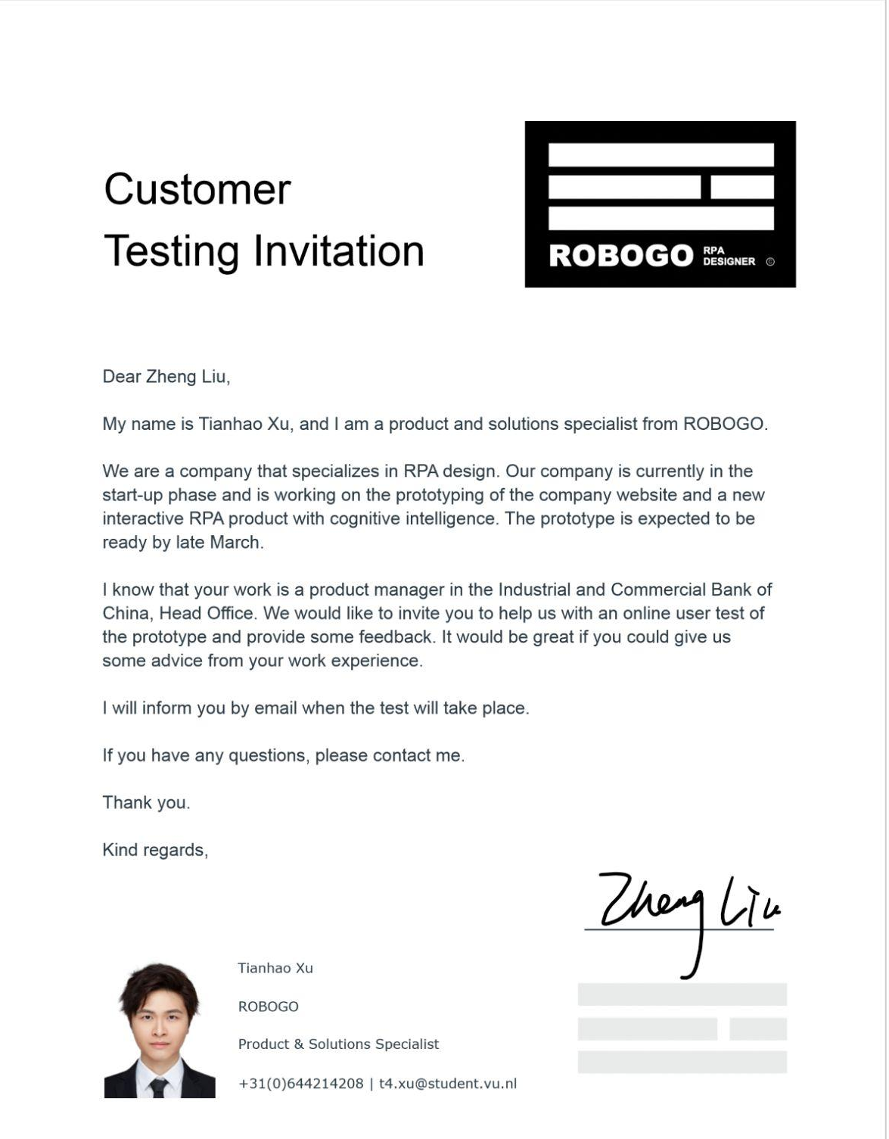

List of candidates for Customer testing
Contact info
Zheng Liu
Financial Product Manager
billy07345@sina.com
The Industrial and Commercial Bank of China, Head Office
http://www.icbc.com.cn/icbc/
Beijing, China
Confirmations letter

Slide 17
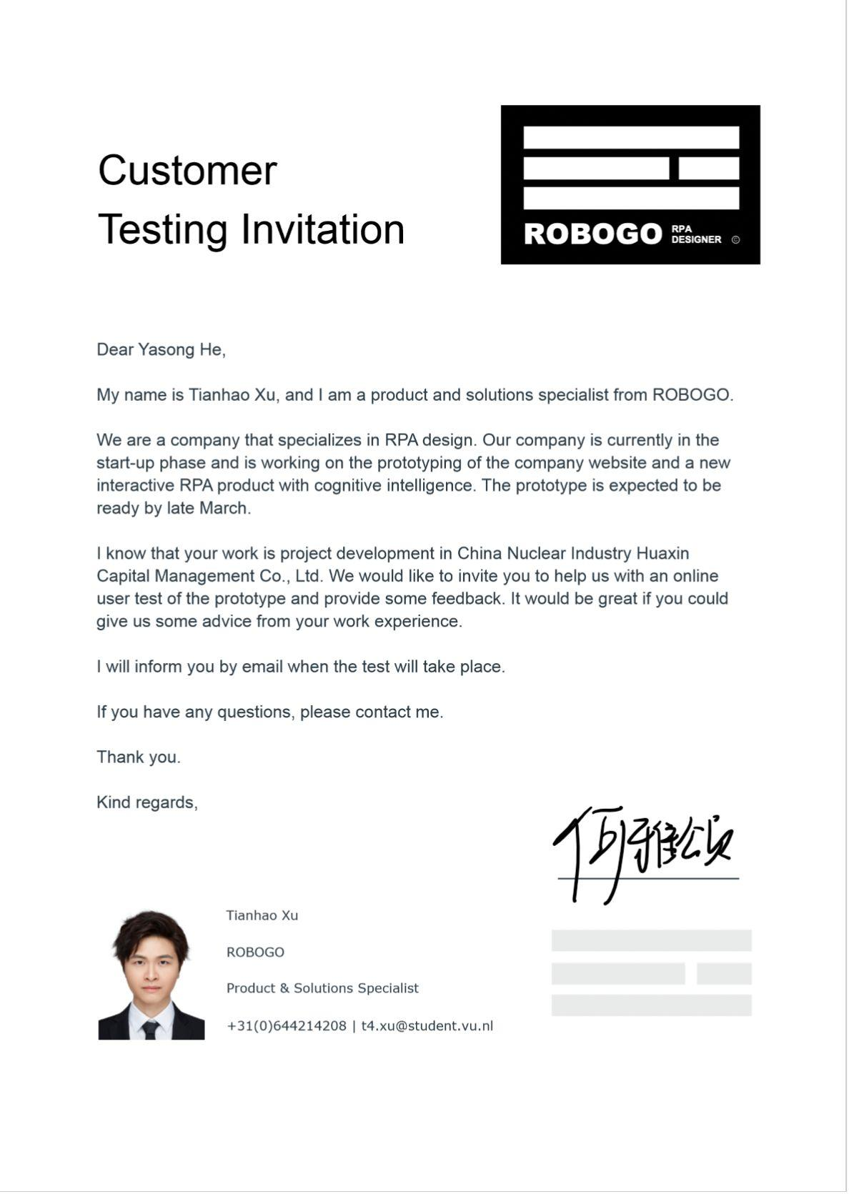

List of candidates for Customer testing
Contact info
Yasong He
Project Development Director
+86 13505281008 | 825967716@qq.com
China Nuclear Industry Huaxin Capital Management Co., Ltd.
http://www.cneccapital.com/
Nanjing, China
Confirmations letter

Slide 18


Expert Interview Notes
Offering out-of-the-box models and easy drag-and-drop AI operations
Yichuan Hu
CTO
Question 1 Can you give some of the great benefits you think RPA can bring based on using a combination of RPA and AI to make a profit?
Hu: Our technology platform is easy to start with because it offers out-of-the-box models, drag-and-drop AI. And our products come with AI embedded, so deployment can be as easy as drag and drop. We combine Robotic Process Automation, Intelligent Document Processing, and Chatbots to help businesses increase efficiency and productivity across the entire life cycle of a business process.
Like in the Retail business, after deploy our order delivery service and customer service, Orders processing, tags generation and delivery management can be automated by RPA robots, RPA will ensure the accuracy of data inputting and most importantly, delivery and consulting is a boring work, and RPA will release staff from these repeat jobs.
Deploying the system with
Simple mouse operation
Reducing the staffs out of the repetitive customer service and data manual operations

Slide 19
Expert Interview Notes
Being passionate about writing code that automates execution during college
Yichuan Hu
CTO
Question 2 How did you discover that you were passionate about AI and RPA?
Hu: Just before I graduated from college, I wrote an infinite loop of code in C. Every second, I would click the mouse at a coordinate position. The procedure is simple, but it could replace tedious manual operation. However, it had a very fatal problem - it couldn’t cope with business changes, the coordinates change.
It was not flexible enough, so we developed a program call “Wizard Button” to perform a series of mouse and keyboard actions in place of the user's hands. After few years to updating this program, we got experience on automatic technology. At about 2015 RPA ushered in "storm growth" and we followed the trend. And I paid more attention to the industry on the breakthrough of underlying technology and use RPA combined with AI, it is interesting to explore its landing application scenarios.
Discovering the inflexibility of the code I write
Focus on underlying technology and use RPA combined with AI

Slide 20
Expert Interview Notes
Traditional banks have many pain points. These are problems that ordinary human resources cannot solve.
Yichuan Hu
CTO
Question 3 What do you think are the pain points in the banking industry, and what can RPA help?
Hu:
We can see that traditional banks have the following PAIN points, like customer contact service pressure, service quality bottleneck, staff capacity can not be improved; high customer acquisition costs, lack of customer operation capabilities, sales funnel conversion rate can not be improved; traditional model data processing efficiency is low, etc..
RPA can do a lot, for example, intelligent financial robot, based on natural language understanding, knowledge mapping, intelligent search and intelligent recommendations and other technologies, to empower the whole business process of customer contact, provide personalized financial marketing, help banks to reduce costs and increase efficiency, improve the marketing turnover rate.
The functions that RPA can do are more comprehensive and efficient than traditional manpower.
Combined with artificial intelligence technology, our goal is to reduce costs and increase efficiency for banks.

Slide 21

Expert Interview Notes
Part of RPA's goal is to improve customer satisfaction and employee morale.
Chao Luo
CSO
Question 4 What are the benefits of combining RPA with AI?
Luo: Part of the aims of RPA are that it is utilized for organizations to achieve the seemingly incompatible goals of increasing customer satisfaction and employee morale while reducing operational costs. There are various gorgeous applications of AI that can be beneficial for RPA. For instance, we can apply natural language processing technology which contains neural network model with optical character recognition to accelerate the processing of documents.
AI helps it make RPA’s basic tasks faster and more accurate, and AI can be understood as an expert in providing state-of-the-art technology. Rpa provides the solutions and ability for tasks that are automatically executed and AI plays the role of efficiency enabler and accuracy guarantor.
AI technology can provide many gains in RPA production capacity.
We need to master the most advanced AI technology to ensure the efficiency and accuracy of the company.

Slide 22
Expert Interview Notes
We could aim at providing users with convenient operation.
Chao Luo
CSO
Question 5 Based on the previous question, can you give some specific business or framework designs for RPA products in combination with banking companies?
Luo: For customers: RPA procedure can improve or replace the traditional reception like counters. Procedures like registering or deregistering bank accounts with RPA only require physical documents(ID, financial related), and the rest of them could be all taken care of by automatic processes.
For employees: RPA can perform as the introducer to train newcomers to get them familiar with working procedures or some fundamental skills. For the more advanced purposes, RPA can analyze the data from previous sales and automatically adjust responding techniques like increasing the deposit in the bank or modifying interest.
Businesses that can develop bank data analysis in the future.

Slide 23

Expert Interview Notes
We can extend to the medical field as well in the future.
Guanchun Wang
CEO
Question 6 By the way, if the product is for medical industry, how does that apply?
Wang: First, intelligent guidance robot can be put into use. It provides guidance services for patients before making an appointment. Under the guidance of the robot, it helps patients choose the registration department and doctor, providing convenience for patients and reducing hospital manpower investment.
In addition to this, RPA can also be used as a medical assistant. It uses NLP to understand user intentions and extracts retrieval conditions. At the same time, robots are used to achieve pre-job training and assessment of medical representatives, and to quickly improve sales capabilities.
Also, relying on the knowledge map, a detailed data system of diseases, patients and medical treatment is established, which is convenient for doctors to query and analyze, and provides a reference for scientific research and diagnosis of diseases.
RPA works as an assistant to recognize the basic disease.
RPA recommends and verifies the doctor's diagnosis.

Slide 24
Expert Interview Notes
The combined application of RPA and AI is inevitable.
Guanchun Wang
CEO
Question 7 Do you have some insight of future trends and innovations in the RPA industry?
Wang: I have seen some predictions. Gartner predicts that by 2022, 90% of the world's large organizations will apply RPA in some form; through 2024, the RPA market will continue to experience high double-digit growth. Therefore, in the future, the RPA market will grow at an ultra-high-speed, and in order to adapt to this market, there will be many innovative breakthroughs.
First, AI will be deeply integrated with RPA, such as strengthening NLP, OCR, deep learning and other fields, and automatically make predictions based on structured and unstructured data. The second is it would realize Hyperautomation, which automates discovery, analysis, design, measurement, monitoring, and reassessment. In the future, RPA will also be applied with a variety of non-IT systems (such as HR systems and financial systems), helping to minimize human errors and ensure data accuracy and visibility.
Our project may work on NLP and other factors to enhance recognition accuracy and match user expectations.
RPA has a variety of application scenarios and a large market space.

Slide 25
Storyboard

Slide 26
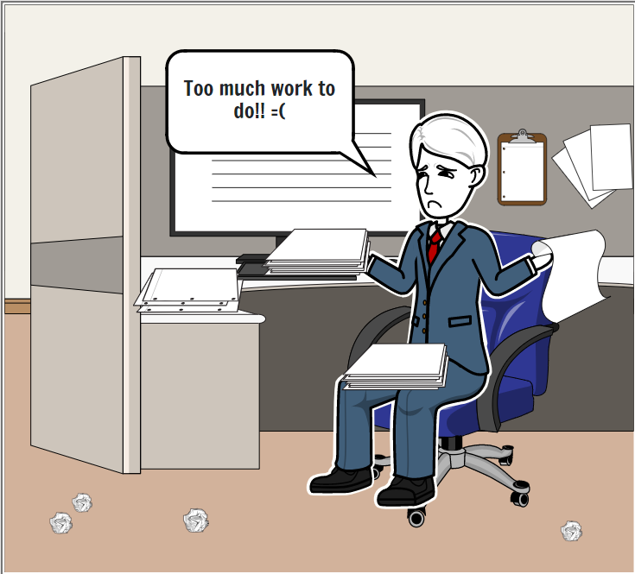
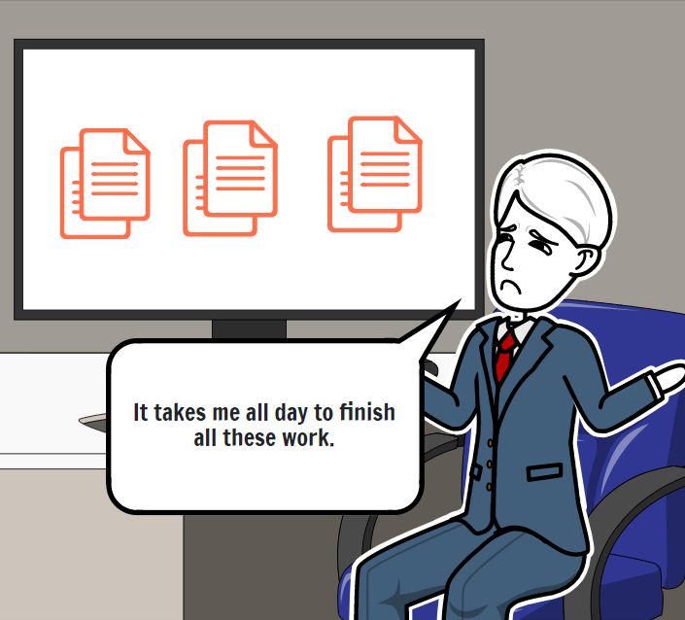
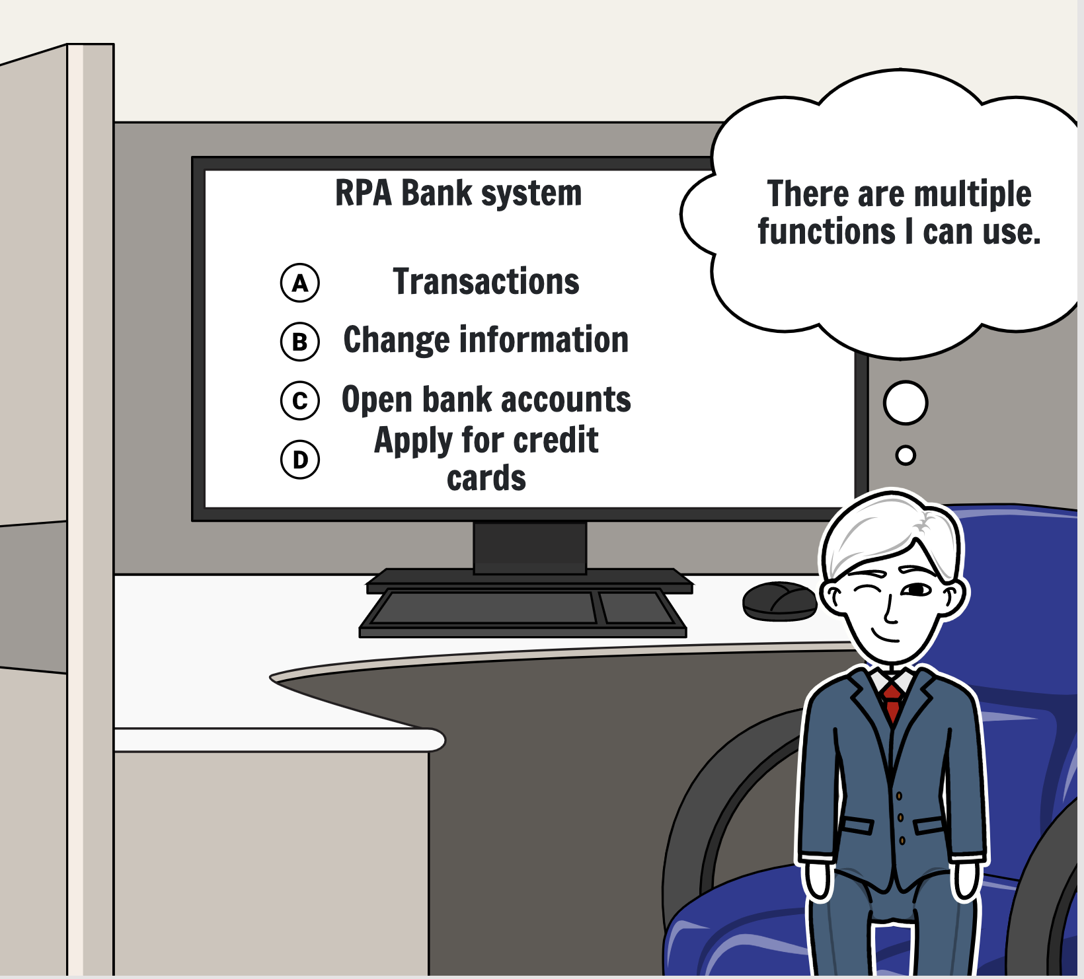
Storyboard

Slide 27

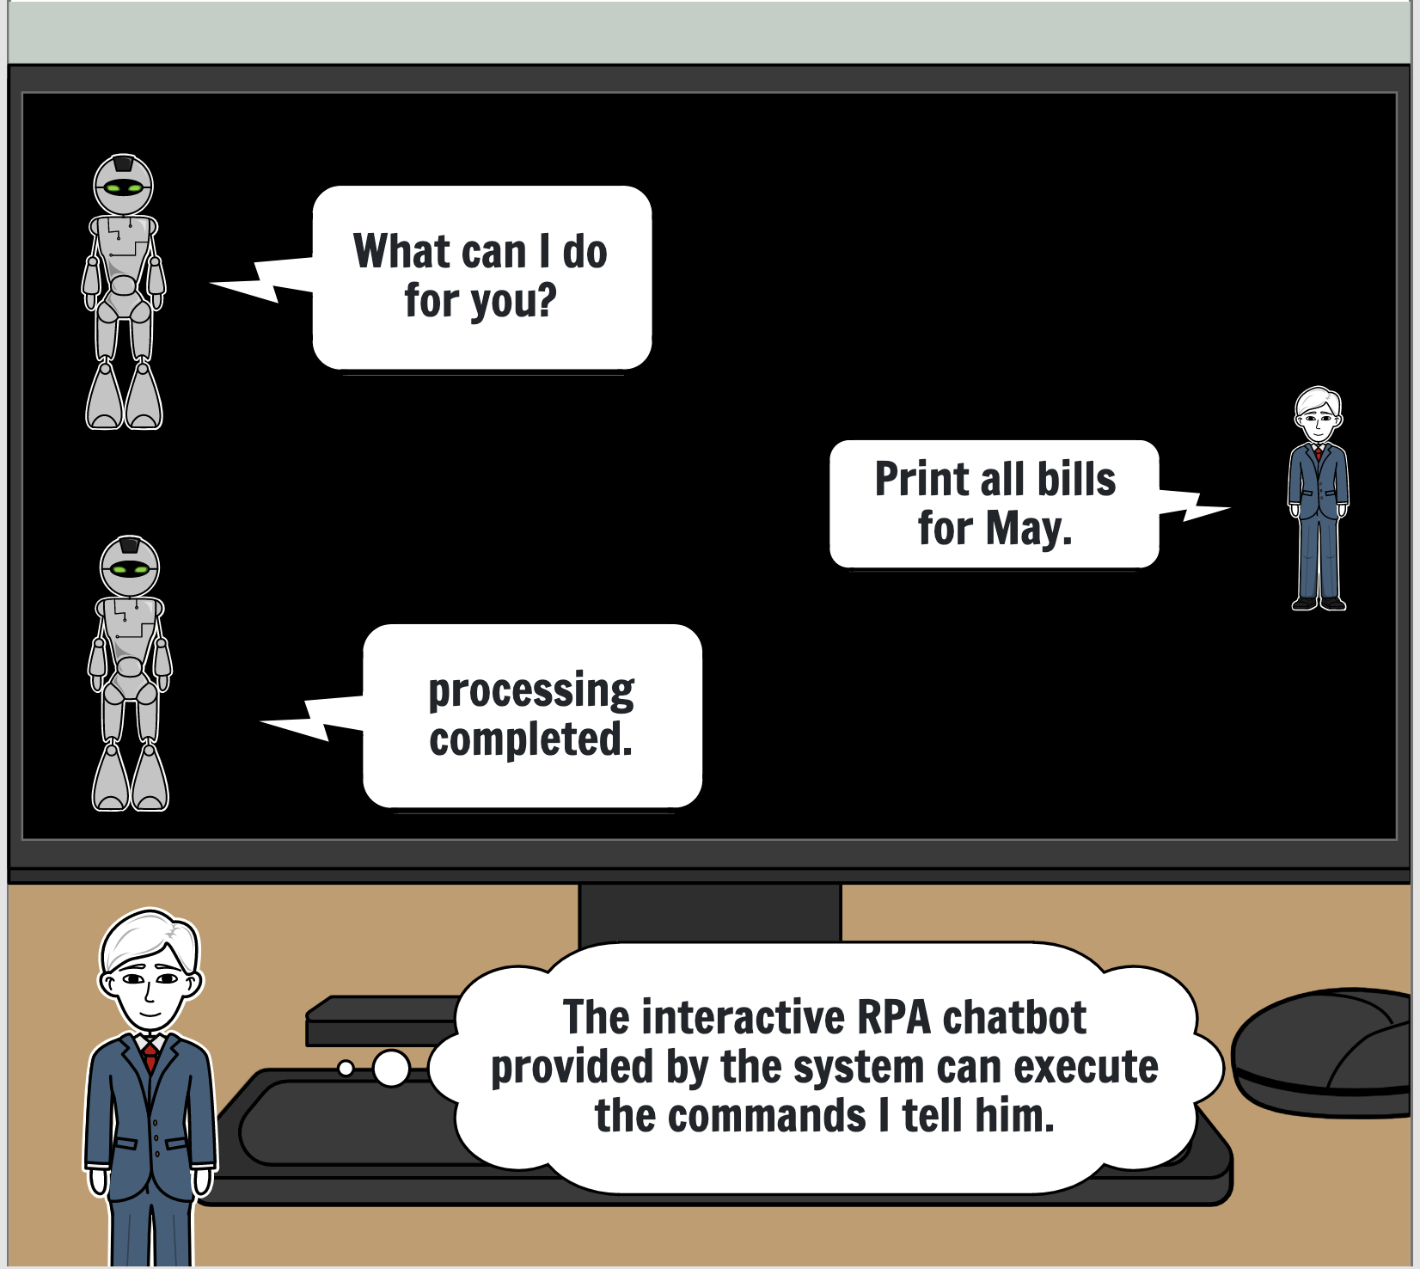
Storyboard

Slide 28
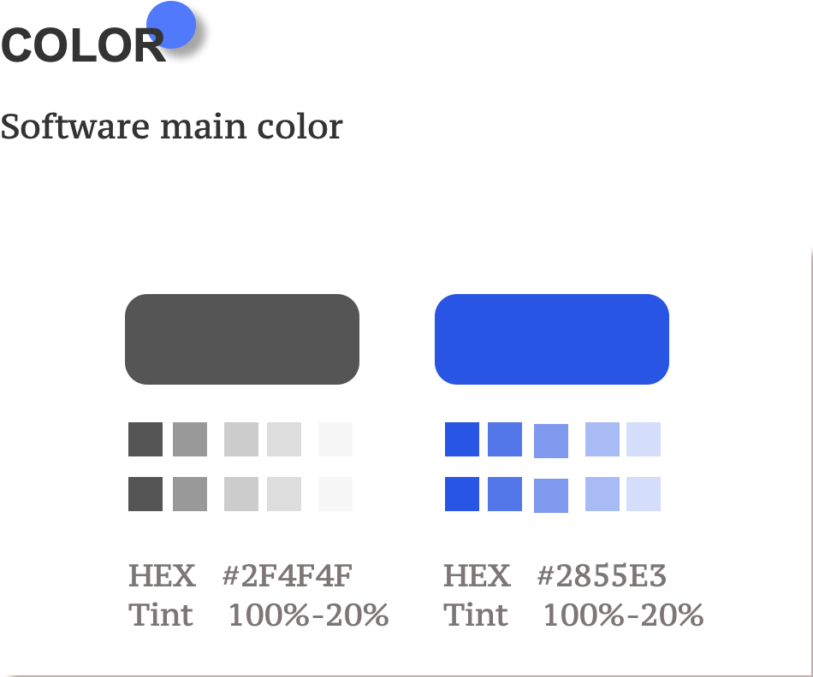
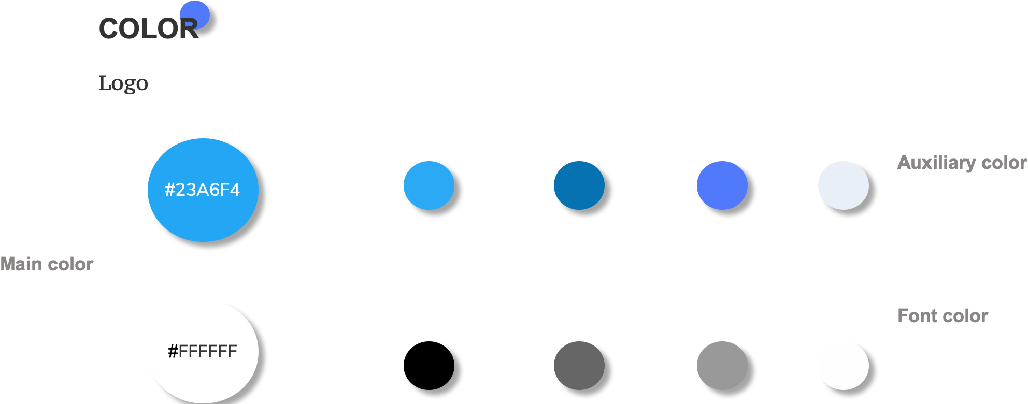

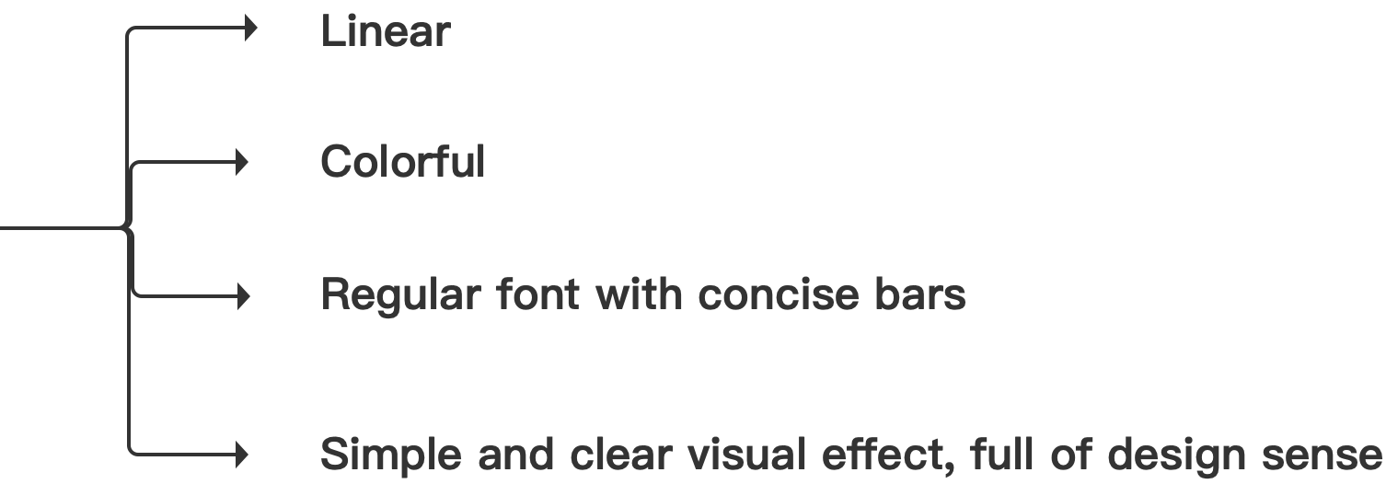
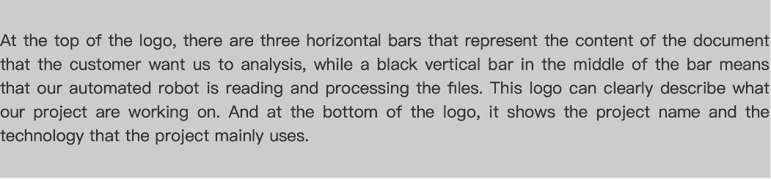
Product analysis

Slide 29
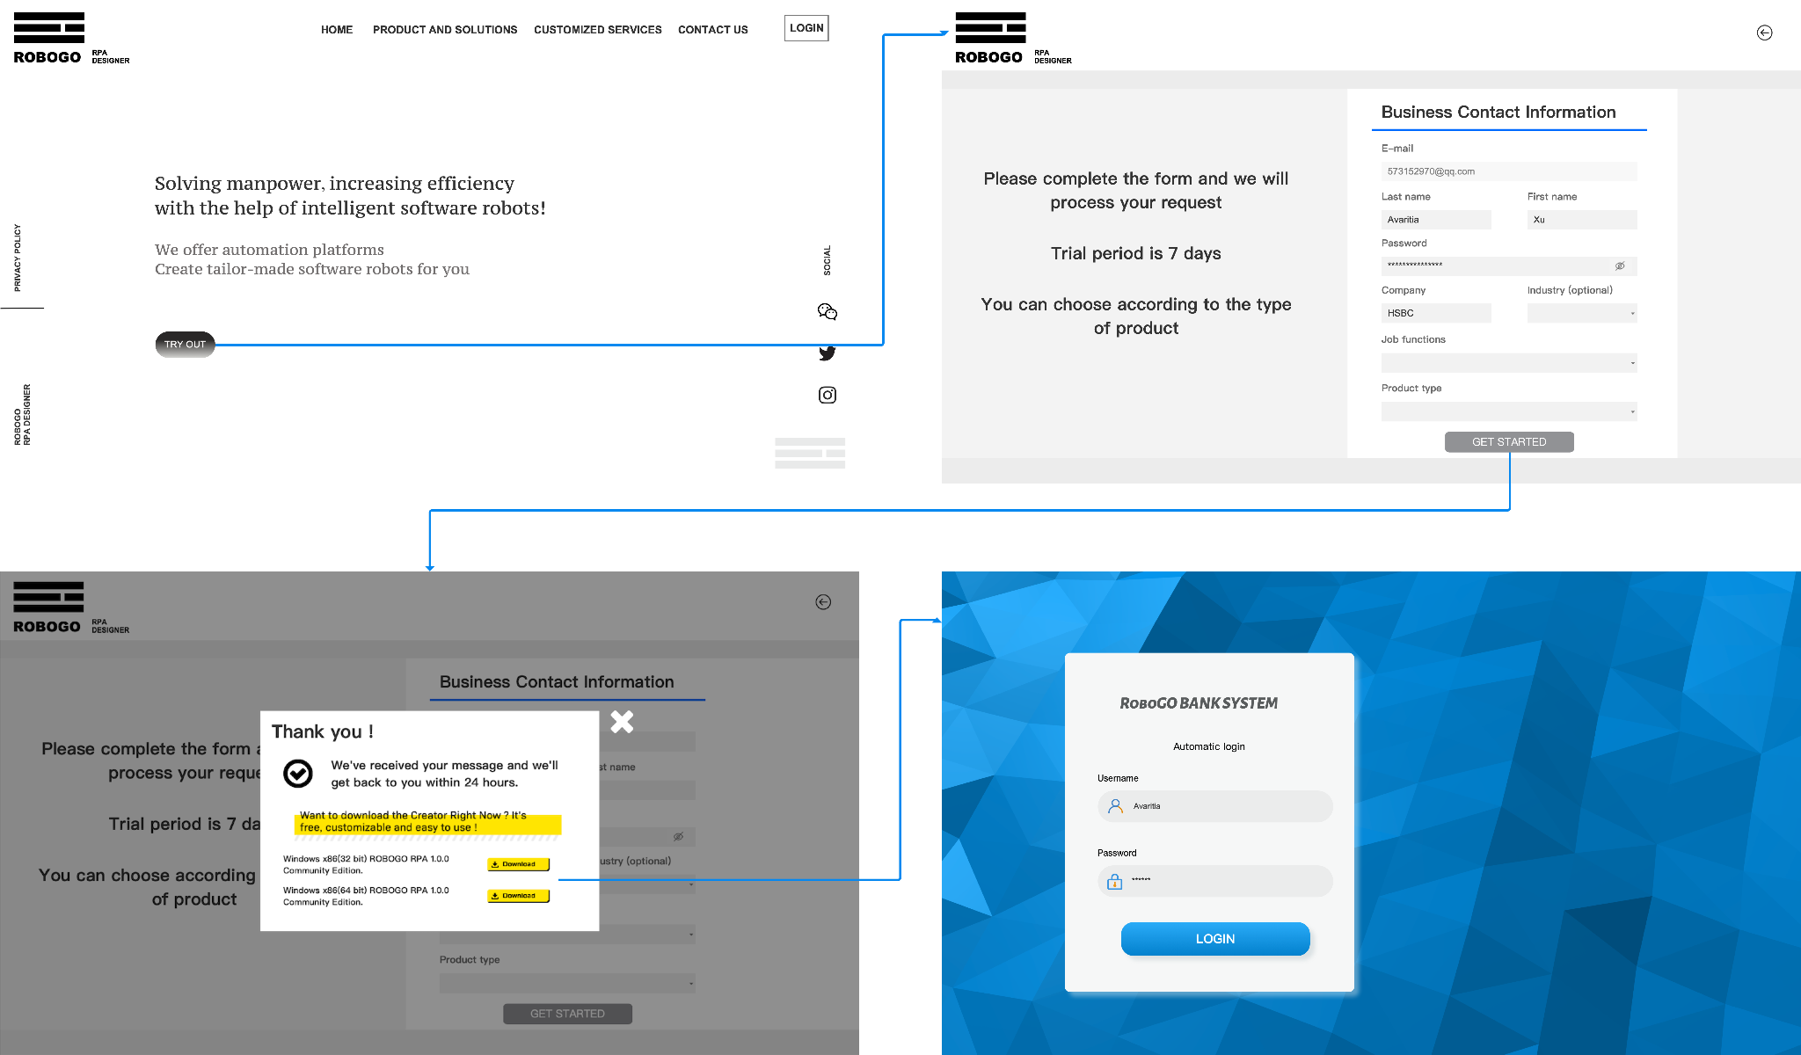
Prototype

Slide 30
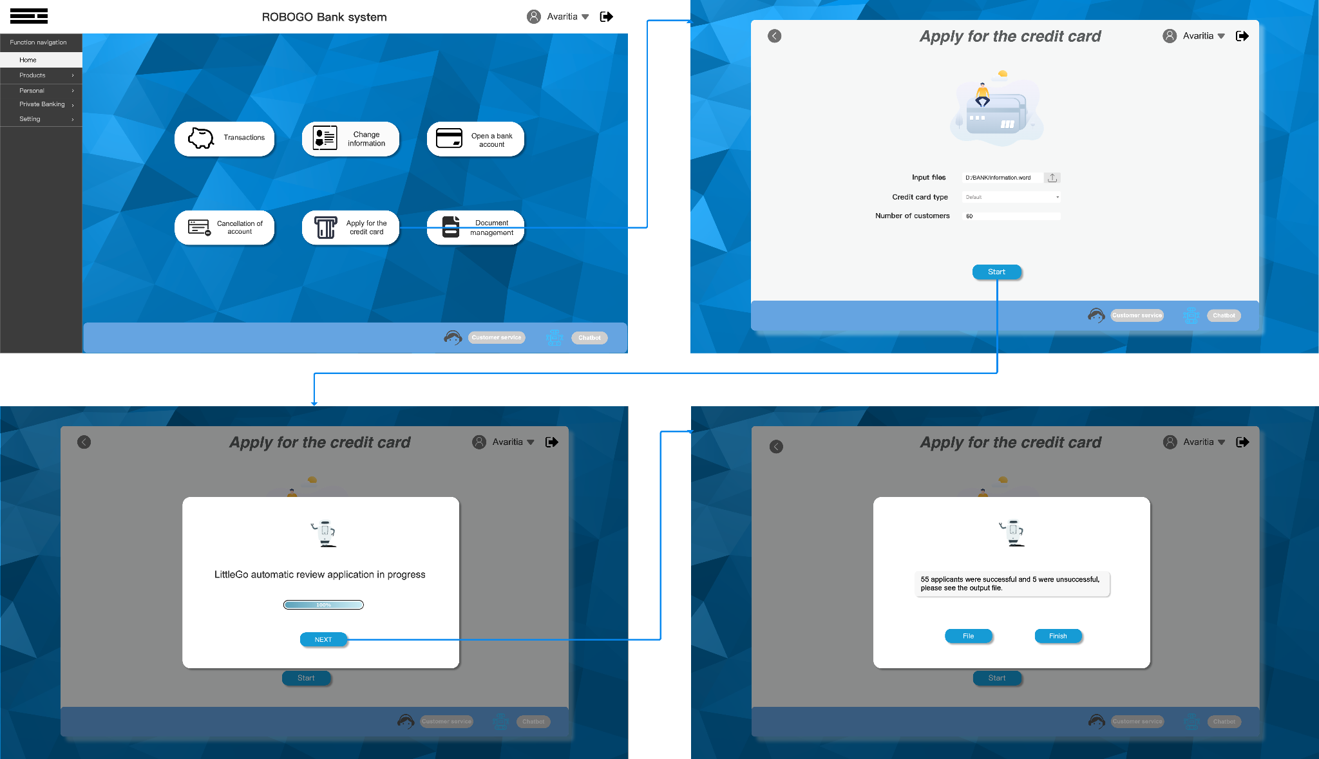
Prototype

Slide 31
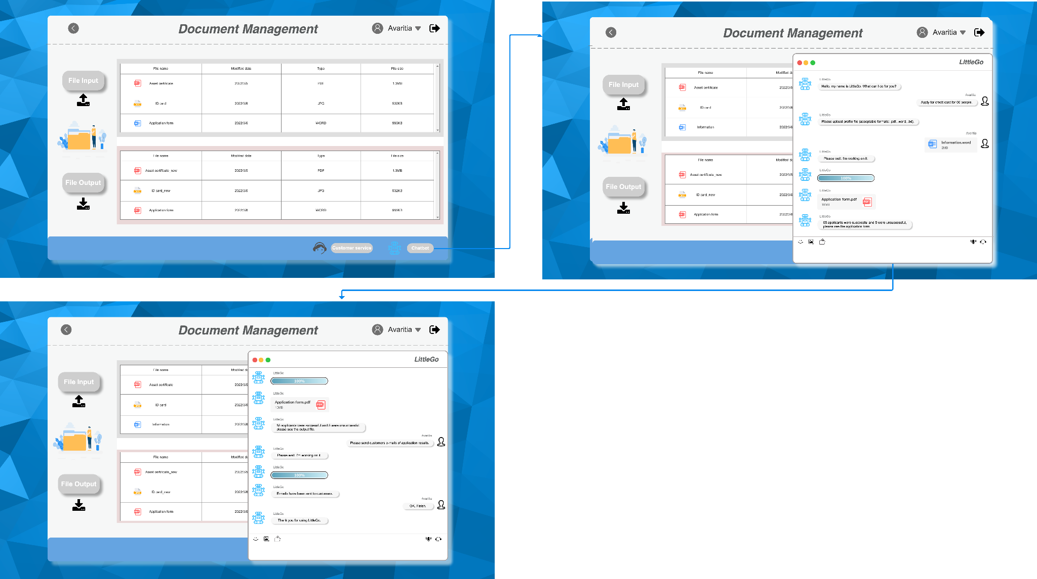
Prototype

Slide 32
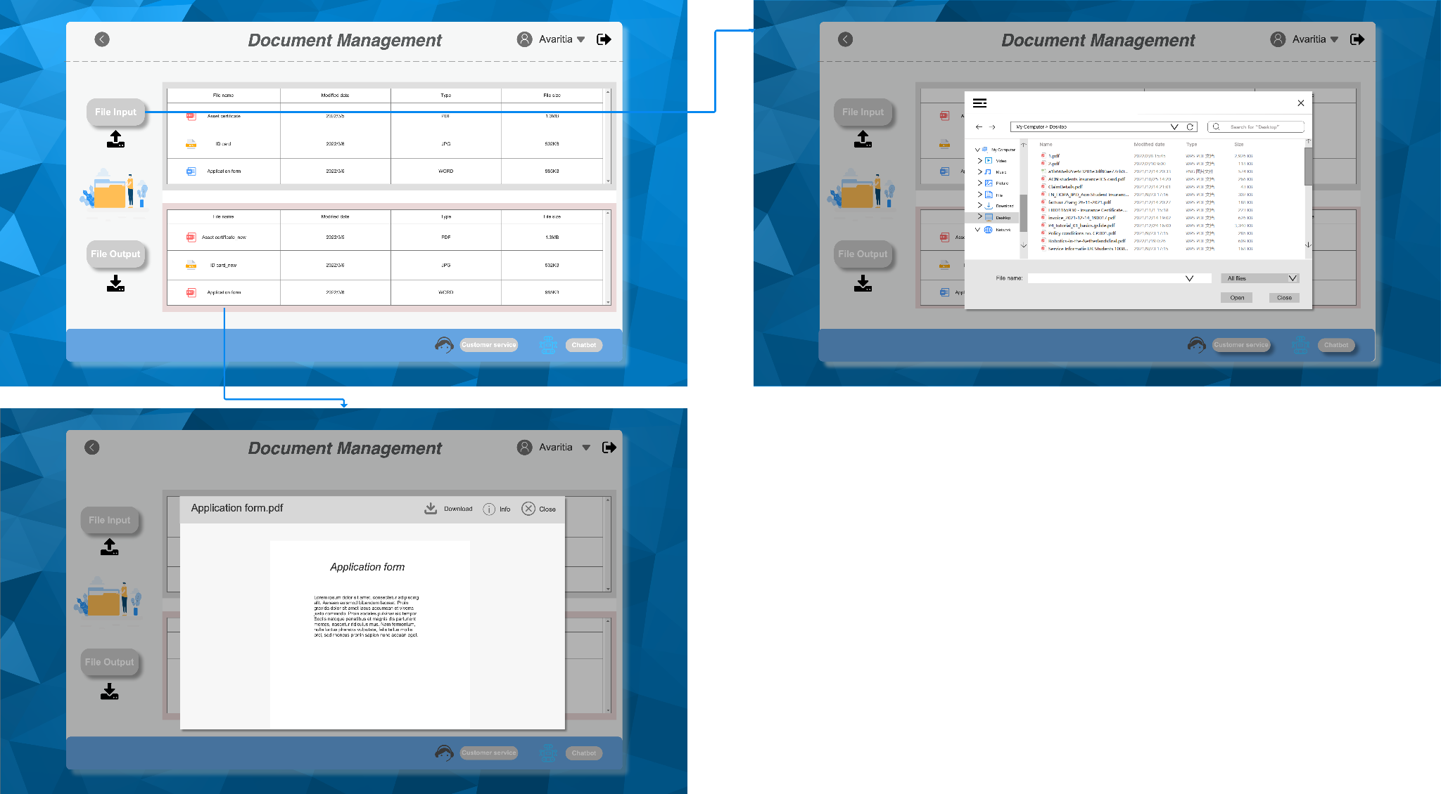
Prototype

Slide 33
Pitch demo

Slide 34

Pain & Gain
Our Product RPA
Unique
Lots & Lots of
REDUNDANT
and
TEDIOUS WORK
Let robots do it!
Focus on Bank business
help bank officers.
Combine RPA and Chatbot.
Interact with people.

Slide 35
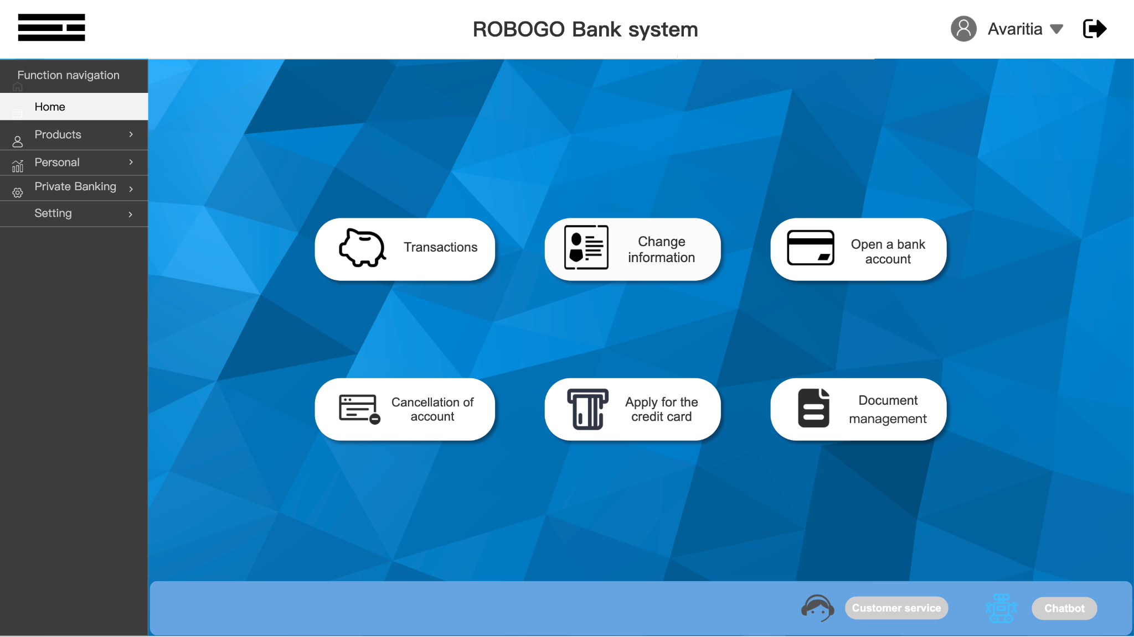
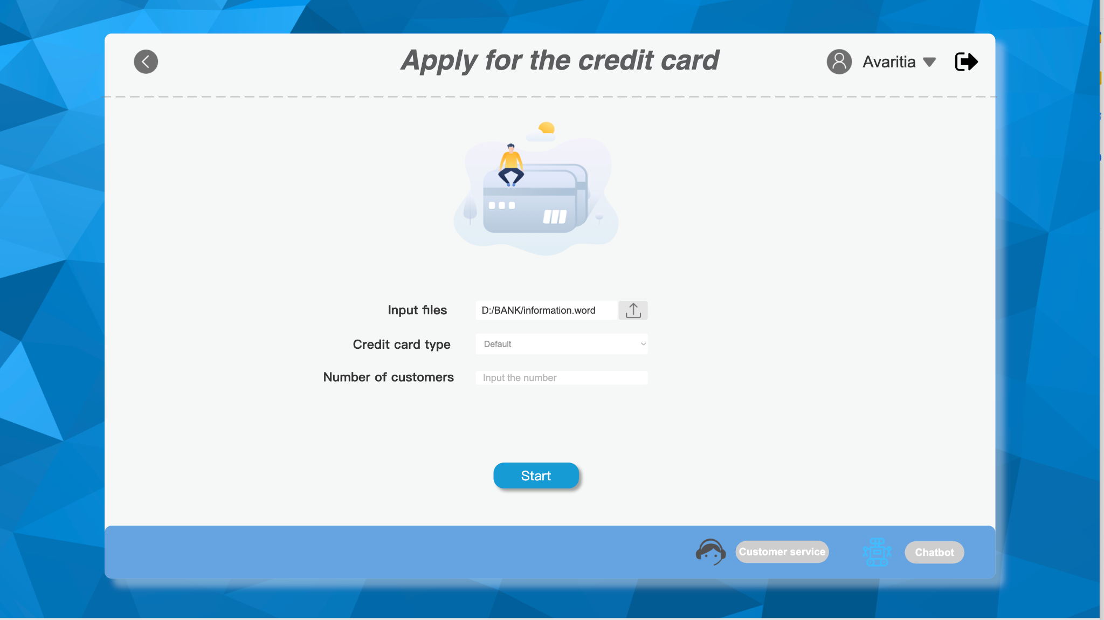
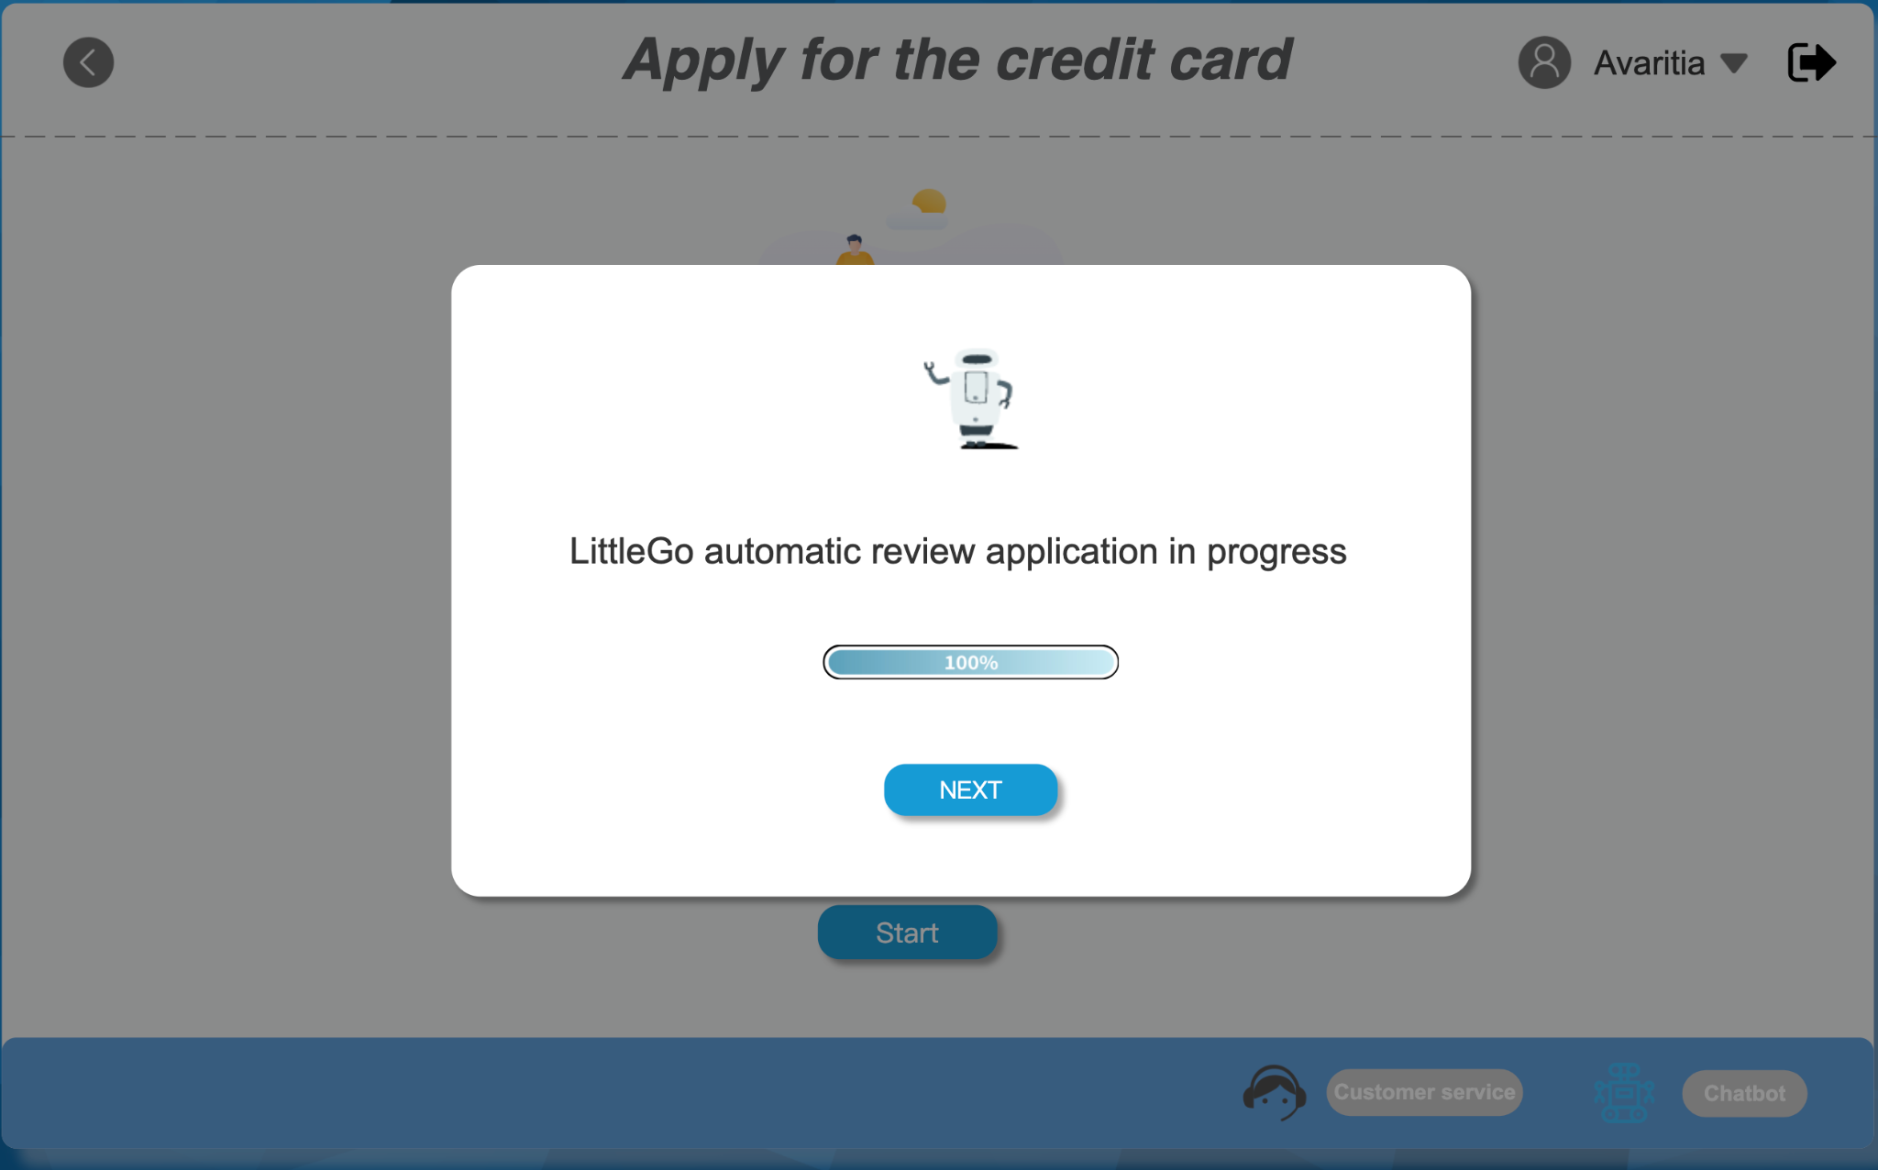
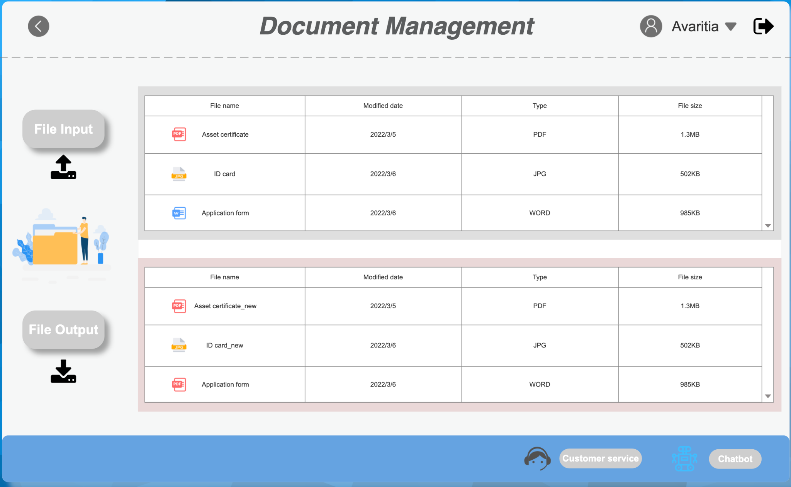
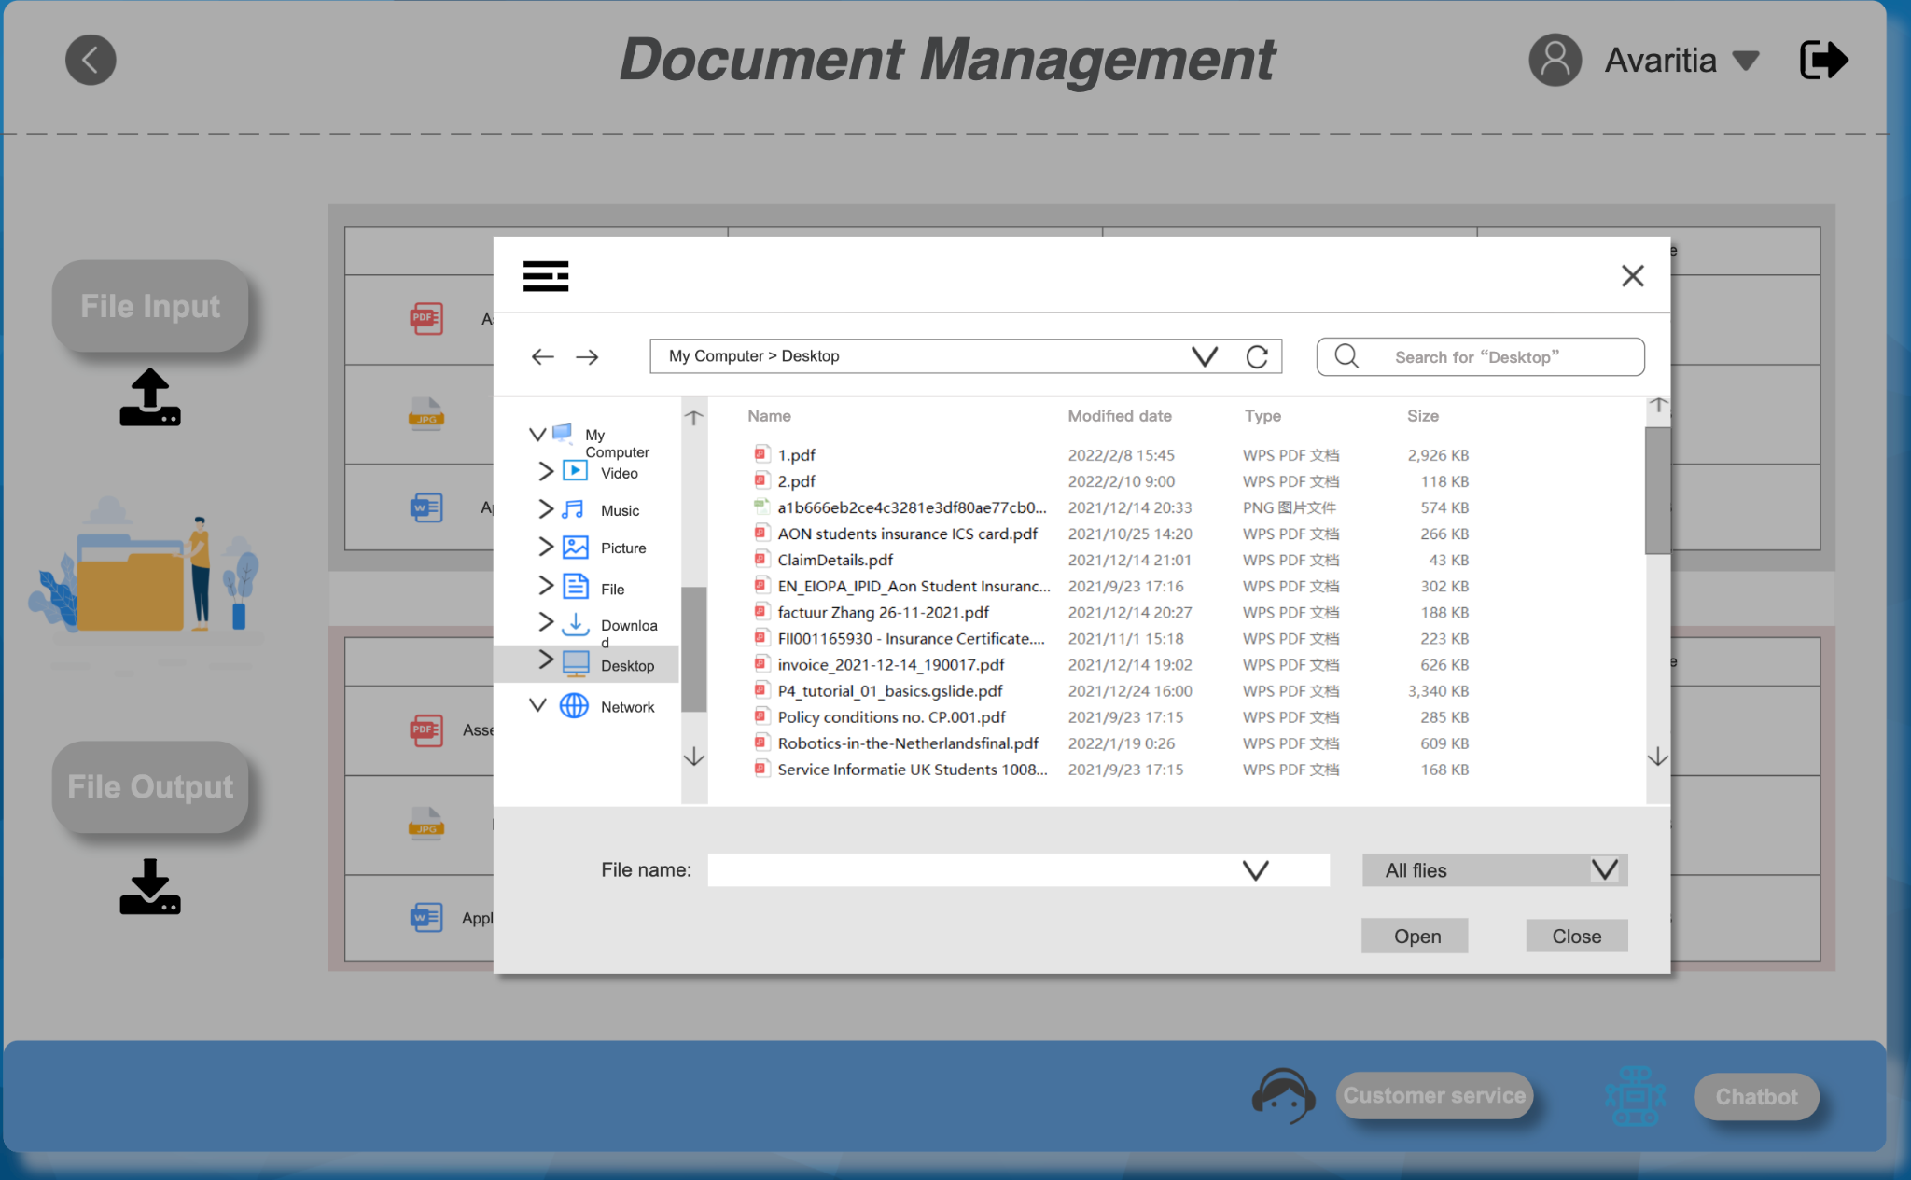
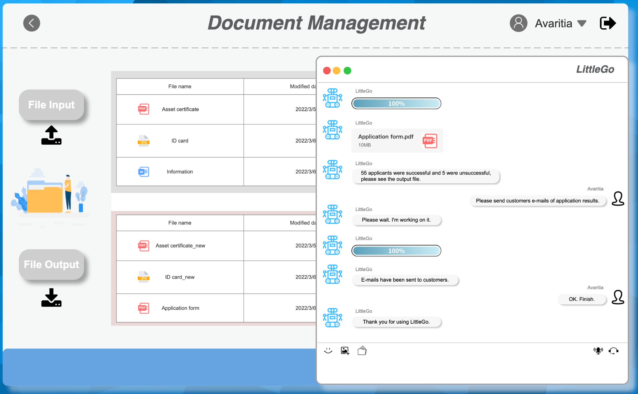
Traditional RPA Vs. RPA Chatbot

Slide 36
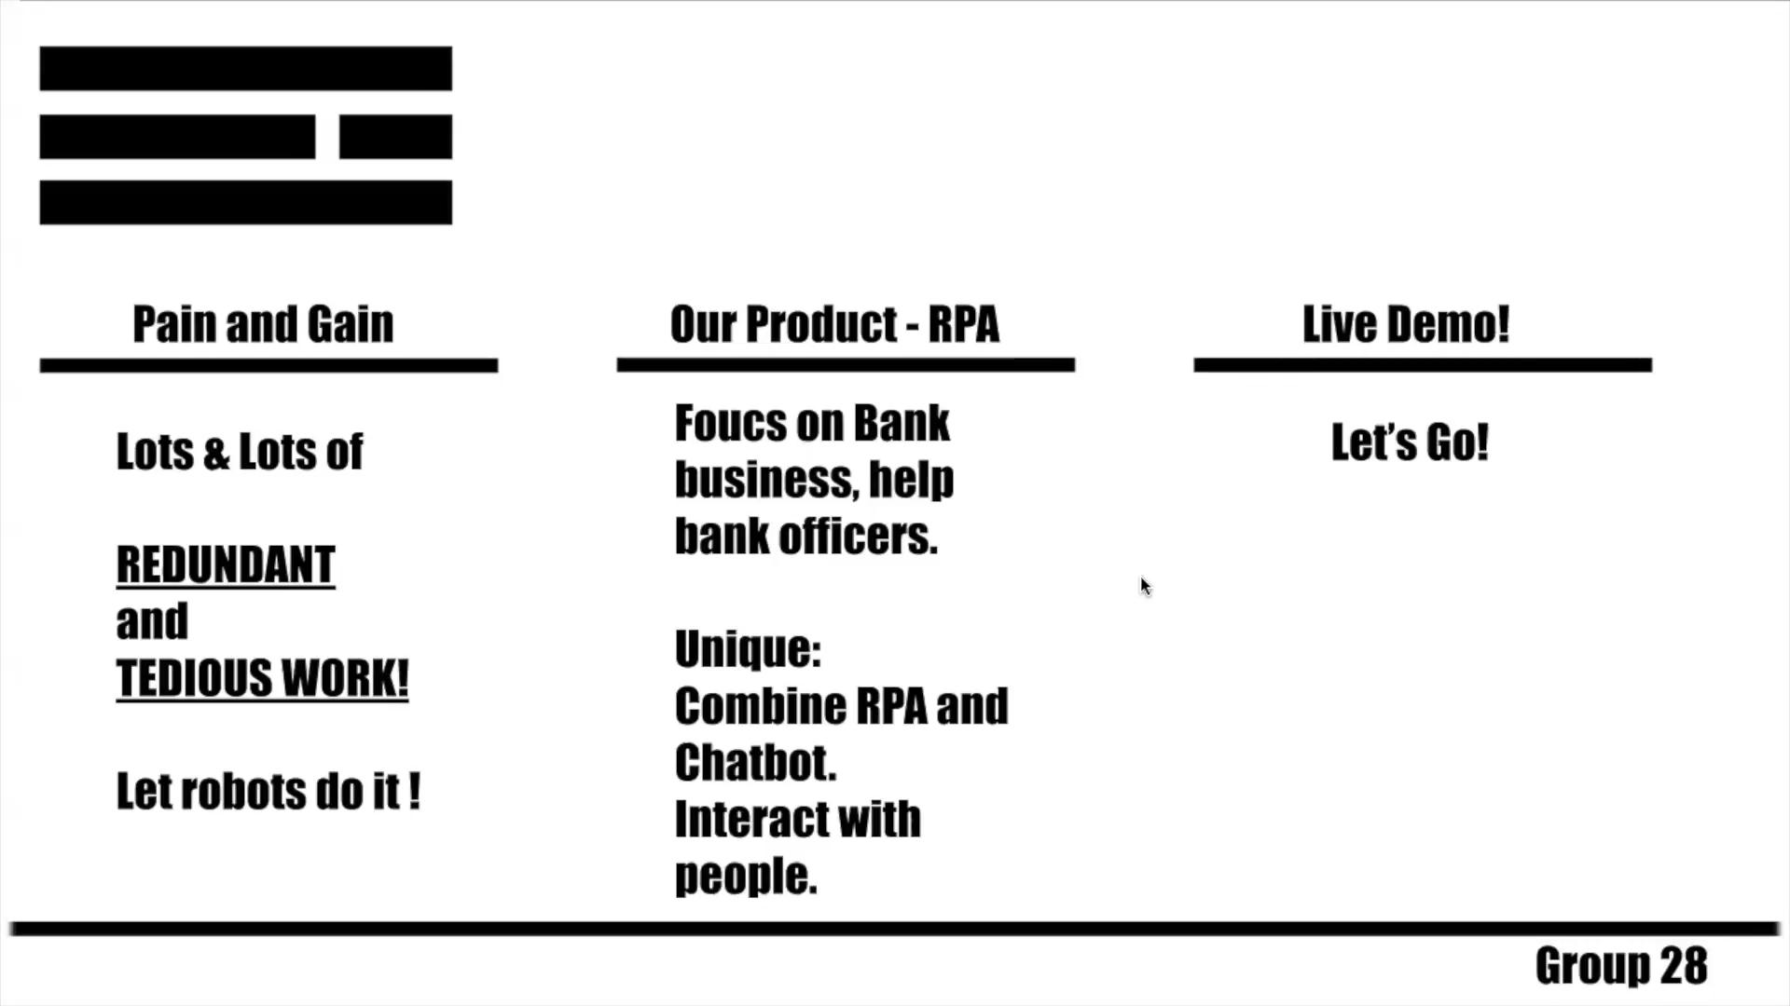

Slide 37
Summary of learnings

Slide 38
Summary of learnings <Xiugou King> - Final
How well did your team work together? Think of ‘opposing perspectives’; are there any? Which ones and how do you deal with them? And, as a team?
Our group has worked flawlessly over the past two months. There are regular 2-3 video conferences via zoom every week. Each time is chaired by the team leader, Tianhao Xu, and each team member has a friendly exchange of opinions or brainstorming. On weekdays, each team member also communicates through WeChat to keep the project updated and report on their progress.
We have encountered "opposing perspectives" in the choice of business objectives.Some team members want our plan to focus on RPA in medical institutions, while others think that RPA in financial enterprises is more suitable. Finally, background information on these two industries was searched through our interviews with professionals and various members of the group. We have a preliminary understanding of the development of RPA in various industries. Since RPA in healthcare institutions involves many specialized system requirements, we unanimously decided to plan RPA for financial enterprises.

Slide 39
Summary of learnings <Xiugou King> - Final
What role(s) did you take as a leader? How did it work out?
Tianhao Xu:
At the first stage, I gathered all ideas and innovations from team members, led the team to do further research on these topics, and finalized the idea about RPA.
During the sprint, I, as a coordinator, examined outcomes and the process of each team member to make the whole teamwork on the right track and keep our consistency.
Han Lin:
During the sprint, we change our roles to make everyone get familiar with the product and our business process.
Mainly I was in charge of describing and introducing our product in detail. And I was trying to beautify and organize the product as our elaborately decorated art.
Ruijia Lei:
During the sprint, I brought quite a lot of insights and brilliant ideas.
My role most is the critic of our team. I thought over and over about the outcomes and results. Also, I made all team members re-think what they have done and what can be improved.

Slide 40
Summary of learnings <Xiugou King> - Final
What role(s) did you take as a leader? How did it work out?
Yiyang Qi:
During the sprint, I broadened our team's version by sharing others' ideas and suggestions from my network.
I functioned as the bridge connecting the team and outside worlds. Using my network made the discussion and innovation process no longer an insides talk. Instead, it became the conversation of our team and other opinions around the world.
Zeyang Zhang:
During the sprint, My role changed after each section since I am capable to fix problems and patch the vulnerability of our team and project. I was in charge of inspecting what we missing and what we still needed to work on. And handle the surprises and incidents during our product building process.
Yunan Lyu:
During the sprint, I took notes of everyone's idea and their plans to merge them into our blueprint. After each discussion and work session, I made team members take a break from our forward process to look backward at what we have done and how we have done it. I summarize the main points of each version of the product and meetings to make us a self-reflection and hopefully an improvement.

Slide 41
Summary of learnings <Xiugou King> - Final
What are your take-aways as you resume your professional life?
Throughout the career life we think there are several important lessons that we have learned:
1.It is very important to conduct the necessary tests before the official launch of the product. This allows us to fully understand user needs, gather informative data, and provide the necessary user data to support R&D. With this approach, we can truly focus on the users and develop and optimize the features they really need and care about.
2.When the decision is made is much more important than what the decision is made. Before starting each decision process, consider how much time and effort the decision is worth.
3.Make it a habit to speed up execution process. If a plan can be executed immediately and strongly, even if the plan is not perfect, this is better than a perfect plan that will come out next week. Because the efficiency gains from plan execution will be better than pointless time wasting, and imperfections can continue to be optimized in the process of execution.

Slide 42
Summary of learnings <Xiugou King> - Final
What are your take-aways as you resume your professional life?
4.The competencies of each individual on the team need to be kept up at all times so that strong execution can be built. The team needs to develop high-impact and impactful projects to do, while ensuring that they are in line with their respective interests, desired value creation and desired growth path. If this is done, everyone on the team will be motivated and passionate in their work.
5.Determining a company's “purpose”, “position” and “personality”, referred to as the 3P, is a key step in building a well-known brand.
6.Concentrate on developing products that really work for the user population and solve their real needs with a simple, easy-to-use product. As a startup, you can't help but develop as many features for your product as possible, but often the cost and development effort is wasted and the focus is distracted, so instead focus on certain real pain points.

Slide 43

Annexes
1
Customer journey
2
Lightning demos
3
Expert interviews
4
Customer interviews

Slide 44
Table of contents
Customer journey
Customer Journey for Enterprise Custom Service
Customer Journey for Online Store
Lightning Demos
Emotibot
LAIYE
Expert interviews
Yichuan Hu
Chao Luo
Guanchun Wang
Customer interviews
Zheng Liu
Yasong He

Slide 45
Customer Journey

Slide 46
Customer Journey for Enterprise Custom Service
Recommendations
Offer more competitive prices and service
Offer fluent content and comfortable UI
Attractive website appearance
Encourage more customer engagement on social media
Make our the user's trial process is smoother
Make UI more simple & user- friendly
Provide the most useful personality dialogue mechanism, omit useless functions
Streamline the buying process
Give discount for long-term customers
Stay in contact with the customer & request a review
Provide free maintenance service to improve customer satisfaction
Offer the technical advice and tutorial to encourage multiple purchases
Ideas to Improve
Buying Cycle
Acquire Days
Nurture Days
Convert Days
Retain Days
Find customers for experiencing the product
Make sure the system fit the company business
Find the best price and suitable services bundle
Decide on custom services & place order
Have a continuous service that suit different situation of the business in company
Customer Goals
Online research
Site visit
Social media
Click on promotional email
Visits product page
Experience the trial process on the RPA chatbot with sample data
See the analysis graphs and AI responses
Add custom services order to cart
Estimate business value
Calculate the cost and benefit of the usage
Order processed email
technical consulting desk
customer service for the product
Touchpoints
What is the RPA chatbot?
Is it necessary on enterprise?
What is the price of this product?
Are there any other competitors offering cheaper price and better usage?
Do they have safety policy for the enterprise?
Am I paying too much?
Is it convenient for all the staff to use?
What functions can this RPA chatbot do?
What is the difference between the normal management assistant?
What is the payment process?
Do they have system maintenance services?
If the system is not suitable, can you refund or change the service
Does the bug or failure getting fixed efficiently?
Is there any discount for the long-term cooperation enterprise?
How to change the service bundle?
Who can we ask for the technical problems?
Customer Thoughts
Overall
Customer Experience

Slide 47
Customer Journey for Online Store
Recommendations
Offer more competitive prices and service
Offer fluent content and comfortable UI
Attractive website appearance
Encourage more customer engagement on social media
Make our the user's trial process is smoother
Make UI more simple & user- friendly
Provide customize design for each enterprise
Streamline the buying process
Offer the technical advice and tutorial to encourage multiple purchases and cooperate
Give discount for long-term customers
Stay in contact with the customer & request a review
Provide free maintenance service to improve customer satisfaction
Ideas to Improve
Buying Cycle
Acquire Days
Nurture Days
Convert Days
Retain Days
Find customers for experiencing the product
Make sure the system can give the effective responses for customer
Find the best price and usage
Decide on purchase & place order
Have a continuous and updating service that suit different situation of the customer operation
Customer Goals
Online research
Site visit
Social media
Click on promotional email
Visits product page
Experience the trial process on the RPA chatbot with sample data
See the commodity recommendation and AI responses
Add service order to cart
Estimate business value
Calculate the cost and benefit of the usage
Order processed email
technical consulting desk
customer service for the product
Touchpoints
What is the RPA chatbot?
Is it necessary on online shopping?
What is the price of this product?
Are there any other competitors offering cheaper price and better usage?
Do they have safety policy for the customer information?
Are we paying too much?
Is it convenient for the customer to know how to use the AI chat?
What can this service do to reduce mutual operation?
What is the difference between the normal customer service?
What is the payment process?
Do they have system maintenance services?
If the system is not suitable, can you refund or change the service?
Does the bug or failure getting fixed efficiently?
Is there any discount for the long-term cooperation enterprise?
Who can we ask for the technical problems?
Customer Thoughts
Overall
Customer Experience

Slide 48
Lightning Demos

Slide 49

Emotibot
Emotibot Technologies is committed to the research and development of cutting-edge artificial intelligence technology, natural language understanding, image recognition, and speech emotion recognition.
Key elements
VCA Smart Customer Service：An intelligent human-machine collaboration system that helps enterprises realize online services.
Zhujian Elf: It can give users warm and interesting responses in open-domain chat scenarios, and can quickly access various channels.
Voice platform: Provide intelligent voice services based on speech recognition, speech synthesis, intelligent interruption and speech emotion detection
Multimodal Emotional Digital Human: Help avatars become able to read, have memory, self-learning, and truly understand human language and expressions.

Slide 50

LAIYE
Laiye Technology combines RPA and AI to achieve intelligent automation as they have built an intelligent automation platform to build, manage and cloud top software bots.
Key elements
Deep learning dialogue engine with outstanding performance
Graphic building experience without coding, making business people masters of robot creation
Support multi-language, rich media interaction, and personalized responses, and make dialogues colorful and individualized
Provide rich, open APIs, platform access and upgraded expansion capabilities

Slide 51
Expert Interviews

Slide 52
Expert interview
Yichuan Hu
CTO
Ph.D., Department of Electrical and Systems Engineering, University of Pennsylvania
Co-founder and CTO of Laiye Technology, mainly responsible for technical implementation and target management
To build an integrated intelligent automation platform

Slide 53
Expert interview
Chao Luo
CSO
Co-founder and CSO of "Lai Ye", responsible for investment and financing, strategy and corporate marketing.
He has worked in Tencent Investment and Bain Consulting and participated in numerous investment, M&A and strategic projects.
Holds a bachelor's degree in electrical engineering from Shanghai Jiaotong University and an MBA degree from MIT.

Slide 54
Expert interview
Guanchun Wang
CEO
PhD of Princeton University, Internet entrepreneur, co-founder of Watch Tonight.
Internet entrepreneur, co-founder of Agannet and Laiye.

Slide 55
Customer Interviews

Slide 56
Develop our business direction
Zheng Liu
Financial Product Manager
Do they understand?
Liu is a product manager at ICBC and their bank is using RPA to help them streamline their business processes. So he thought our product was very good and he was willing to promote it.
He introduced us to the RPA application scenarios they were using and the areas that needed the most improvement, so with his help we developed our business direction and long term goals that would, for example, improve the efficiency of online credit card applications.
He suggested that we resize the prototype design drawing to fit the size of a web page in a real working environment.
Confirm the long term goals
Resize the prototype design drawing

Slide 57
Customer interview format (2/3)
The system automatically compares the image content in the reimbursement form with the system input, and reviews the compliance and completeness of the reimbursement content.
(How ) Does it solve?
Key elements
As a bank employee, the RPA has greatly improved the efficiency of the entire company approval process for my reimbursement of expenses incurred due to business travel.
When referring to the processing flow, I must mention that once I scan and import a standard reimbursement claim form, the RPA system firstly shows that it is being processed.I don't know what's going on here, but compared to the old way of of manual review by passing to different administrative staff that could take hours or even days, using RPA system might only take a few minutes, which is very efficient.
The prototype design drawing was resized to 1920*1080 for a better fit on the web.
Moreover, according to the reimbursement policy, it will return the approval opinion, and for those approved, realizes automatic bookkeeping, record review and payment. Those are what we focus on.
The long-term goal of our company is to try to improve the efficiency of internal administration.

Slide 58
Customer interview format (3/3)
What other projects/initiatives also tackle the same challenge?
Key elements
RPA Labs, Brendan McKittrick(CEO)
RPA Labs provides products for logistics to manage the tracking system. It serves as a quick-deployment, independent system to the existing system.
Blue Prism, Ian Horobin(Chief Product Officer)
Blue Prism focuses on the automatic robotic process, especially the interaction between human workers and robots.
Our project targets the bank. And the bank system is highly secure and also vulnerable. The idea of "as an independent system" is what we want to make our product a non-invasive and safe third-party service.
The interaction gives us so many insights. For the bank clerk, to put all the work into a robot might be risky. So a smart assistant might take the lead in this situation.

Slide 59
Yasong He
Project Development Director
Do they understand?
Her company haven’t use RPA before. She was very interested in this product after our presentation and was ready to start to use it from the company's sales department and fund investment departement.
Yasong takes part in fund affairs of her company and RPA was introduced and used in the fund department for assisting the publishment, data monitoring and maintenance. She has been very helpful in advising us on the design of our RPA interactions through her project experience.
She suggested that we can introduce more data-related features and combine NLP techniques in text processing to make the work more efficient.
Help us design our RPA interactions
Suggest us
focus on the user
experience
Draw the high-fidelity prototype

Slide 60
Customer interview format (2/3)
For funds and other investment transactions, RPA is very beneficial because our products are extremely sensitive to data
(How ) Does it solve?
Key elements
It is quite beneficial for a lot of affairs. Especially for something which will utilize data control functions like investment transaction opening monitoring and data management, fund product establishment, issuance, change, maintenance, liquidation, etc.
Yasong’s projects contains helping the company publish quarterly fund reports, and the financial statements, various asset details, expense details, share status and other data in the fund's periodic reports are subject to a series of accounting and auditing by the accounting firm.RPA robot combined with NLP technology can replace the manual extraction of report data from Word documents to Excel tables, and combined with all the collocation verification, system data verification, can all data verification work can be completed quickly and efficiently.
We have focused on many processes and improved and added more features during the launch and maintenance of our fund products

Slide 61
Customer interview format (3/3)
The products are similar to the others in the interviews. What attracted us was the business and profit model UI Path developed. It makes RPA a package rather than an unknown and complex system. Customers can easily apply for demos and subscribe to the services.
What other projects/initiatives also tackle the same challenge?
Key elements
UIPath, Daniel Dines
UI Path provides a similar product for banks and finance systems. It got mature and whole packages for different kinds of activities. It has also grown a complete business pattern for customers from the trial demo to the actual application.
UI path is the one that has a similar service as ours. It warns us not to take the old track they took, so we bring the interaction like "chatbot" into our product.

Slide 62
Thank you.
Contact information:
Tianhao Xu
t4.xu@student.vu.nl
+31(0)644214208

